Slide 1

WEBSITE

Slide 2

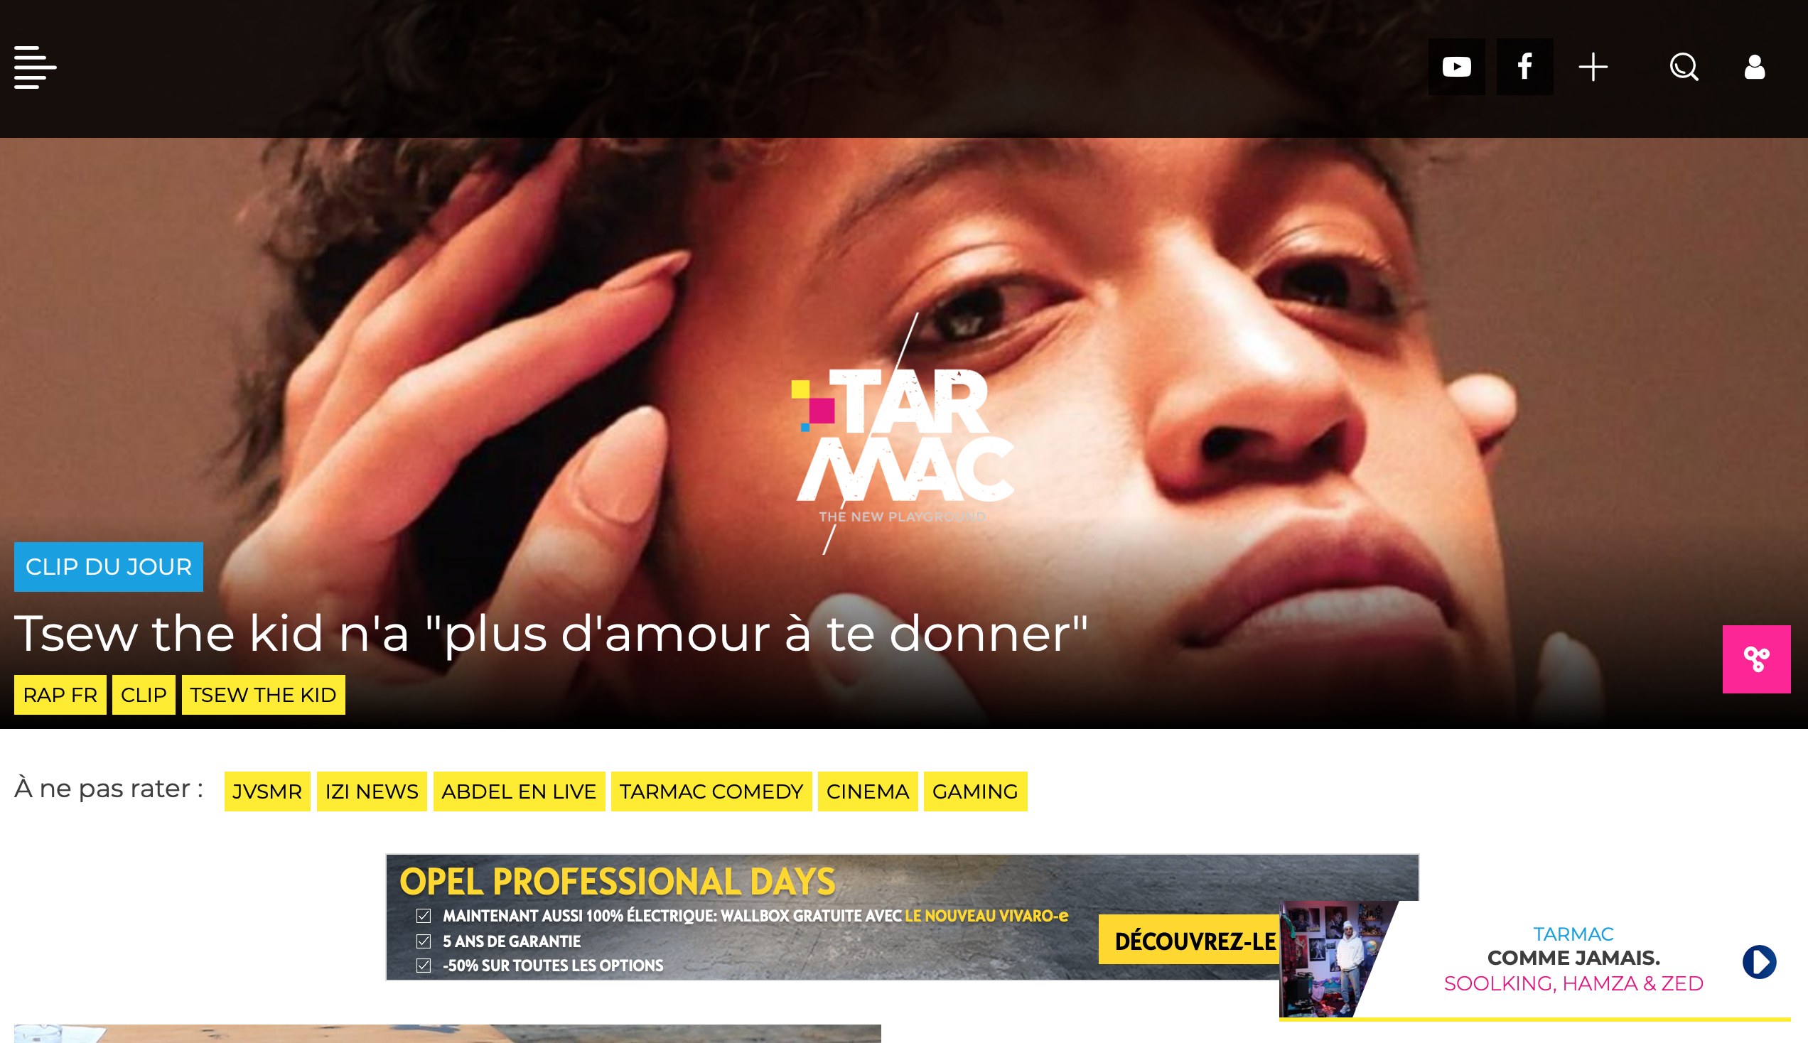
INSPIRATION:
MEDIA
Tarmac
Konbini
Trax
Medium

Slide 3

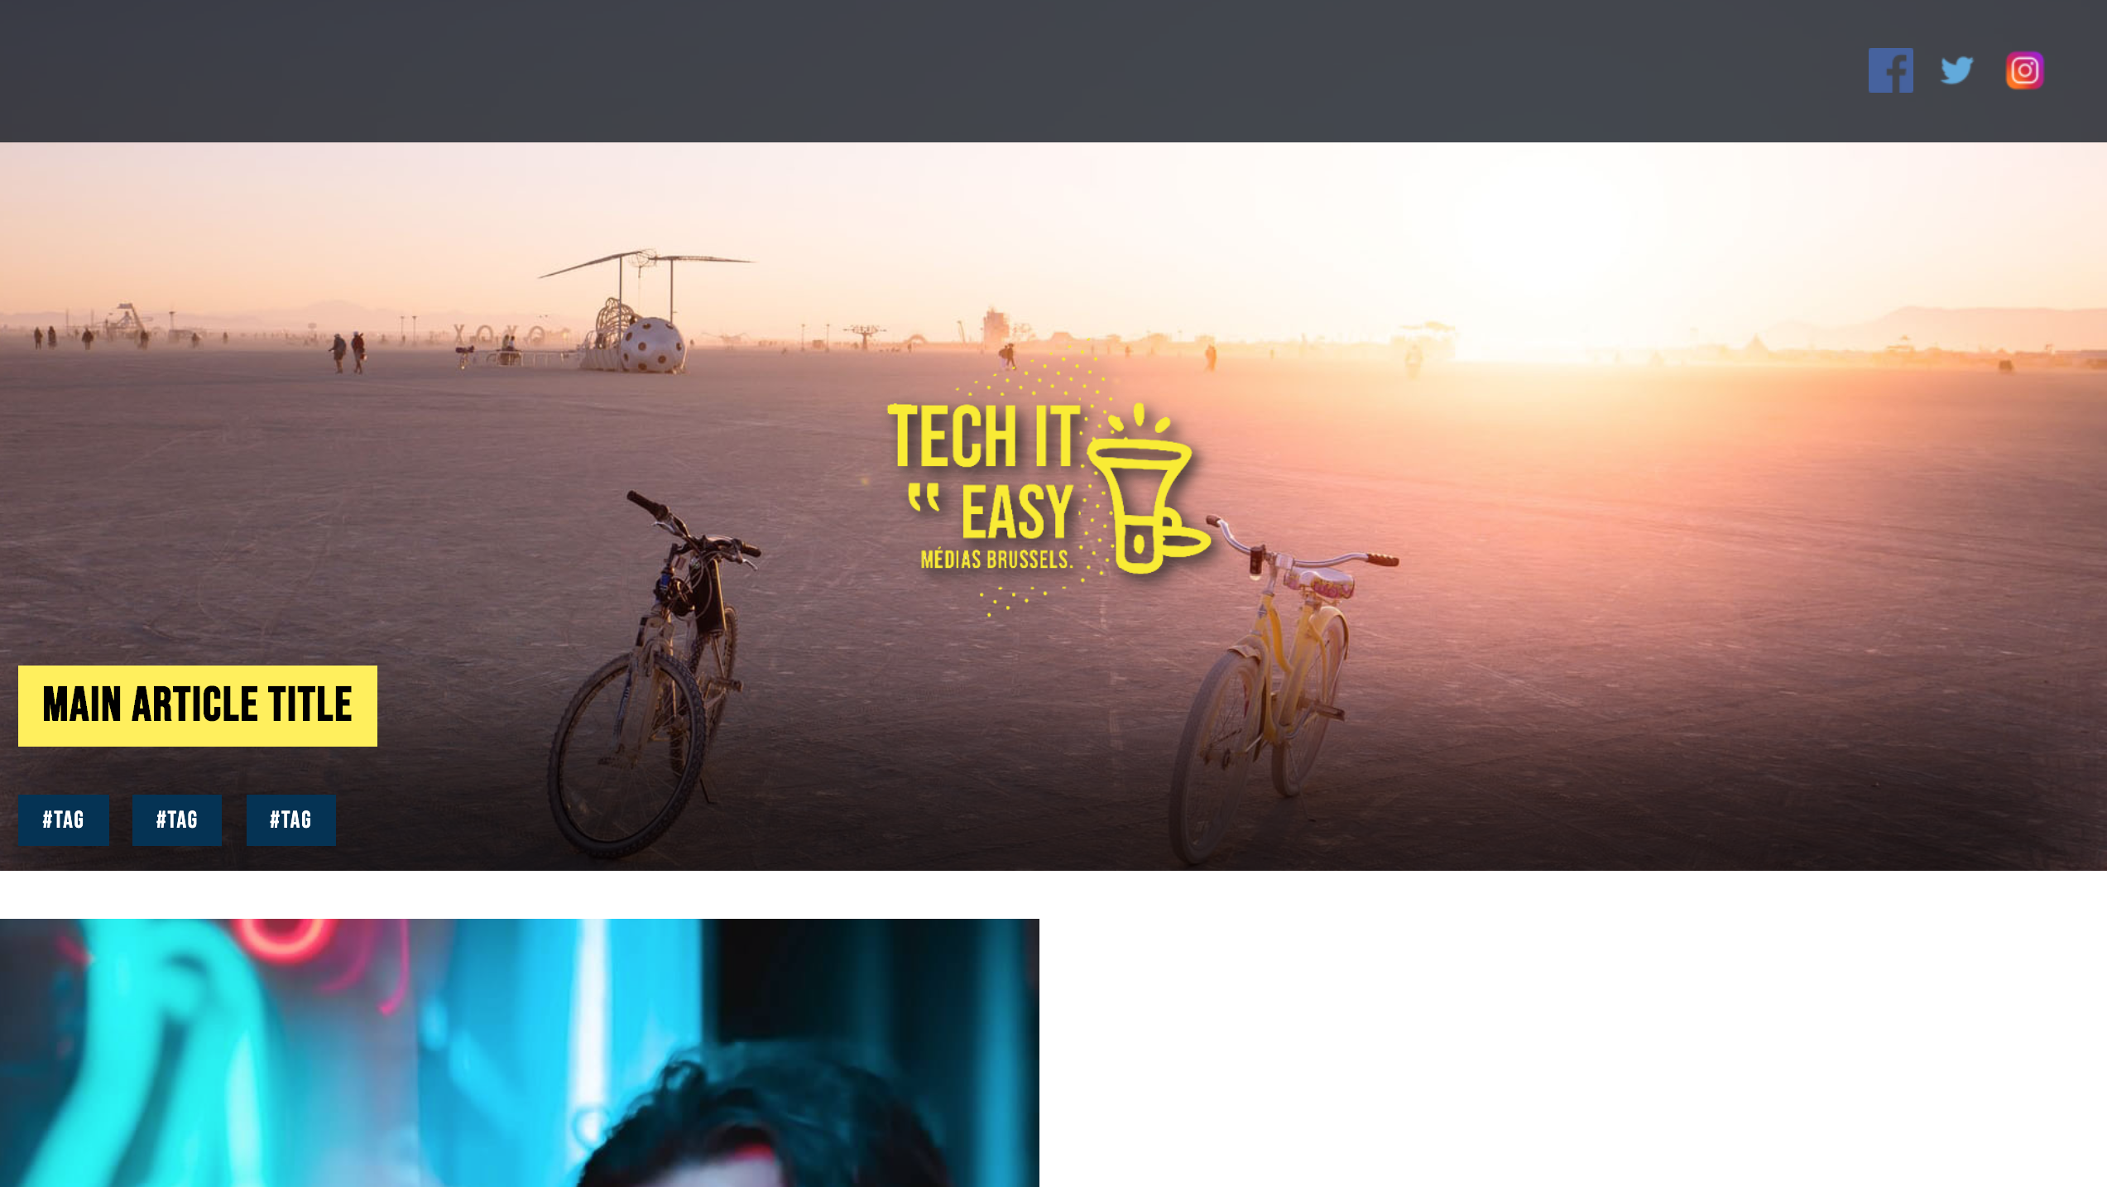
MAIN PAGE

Slide 4

Main Page:
Nav Bar

Slide 5
MAIN PAGE:
Header & parallax

Slide 6

MAIN PAGE:
Grid System

Slide 7

ARTICLE PAGE:
Header

Slide 8

ARTICLE:
Content oriented

Slide 9
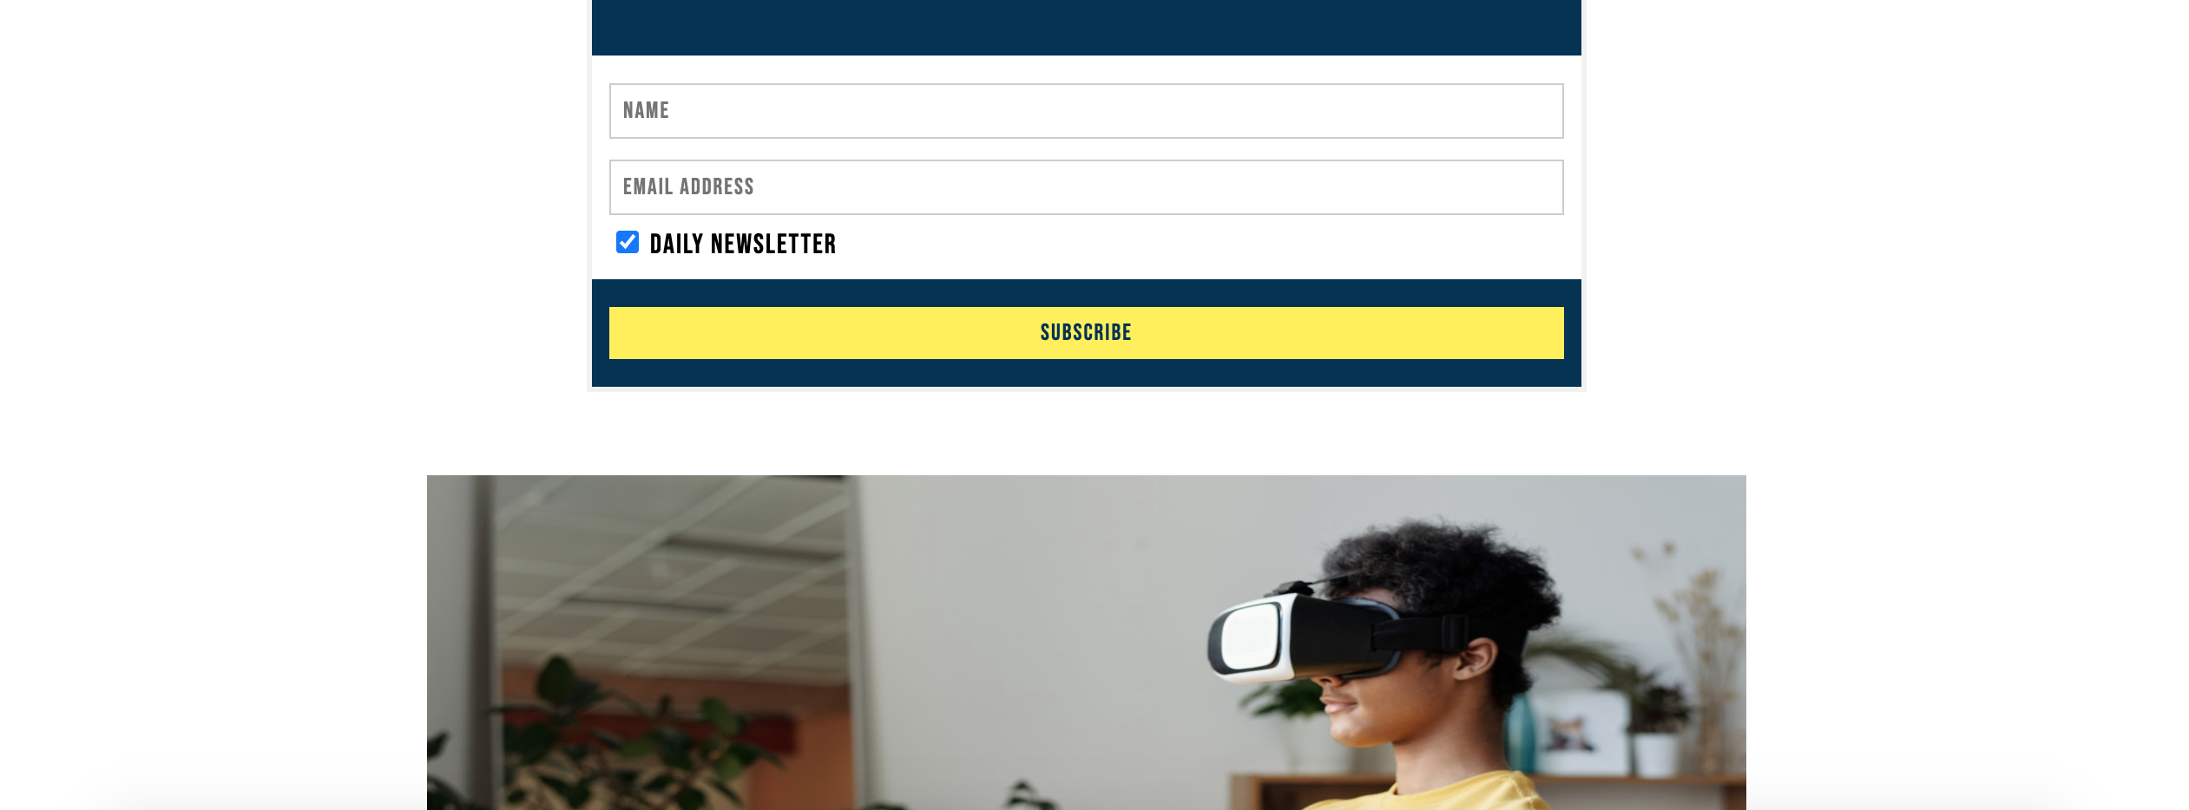

ARTICLE:
Infinite scroll

Slide 10

ARTICLE PAGE:
Share Buttons

